Slide 1
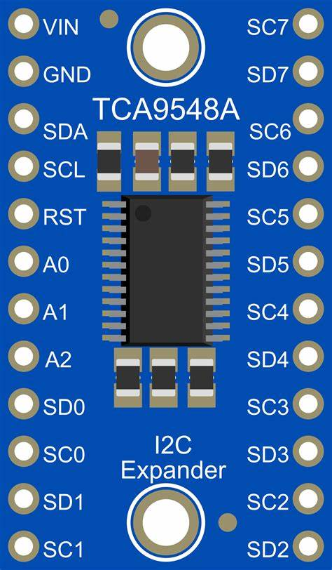
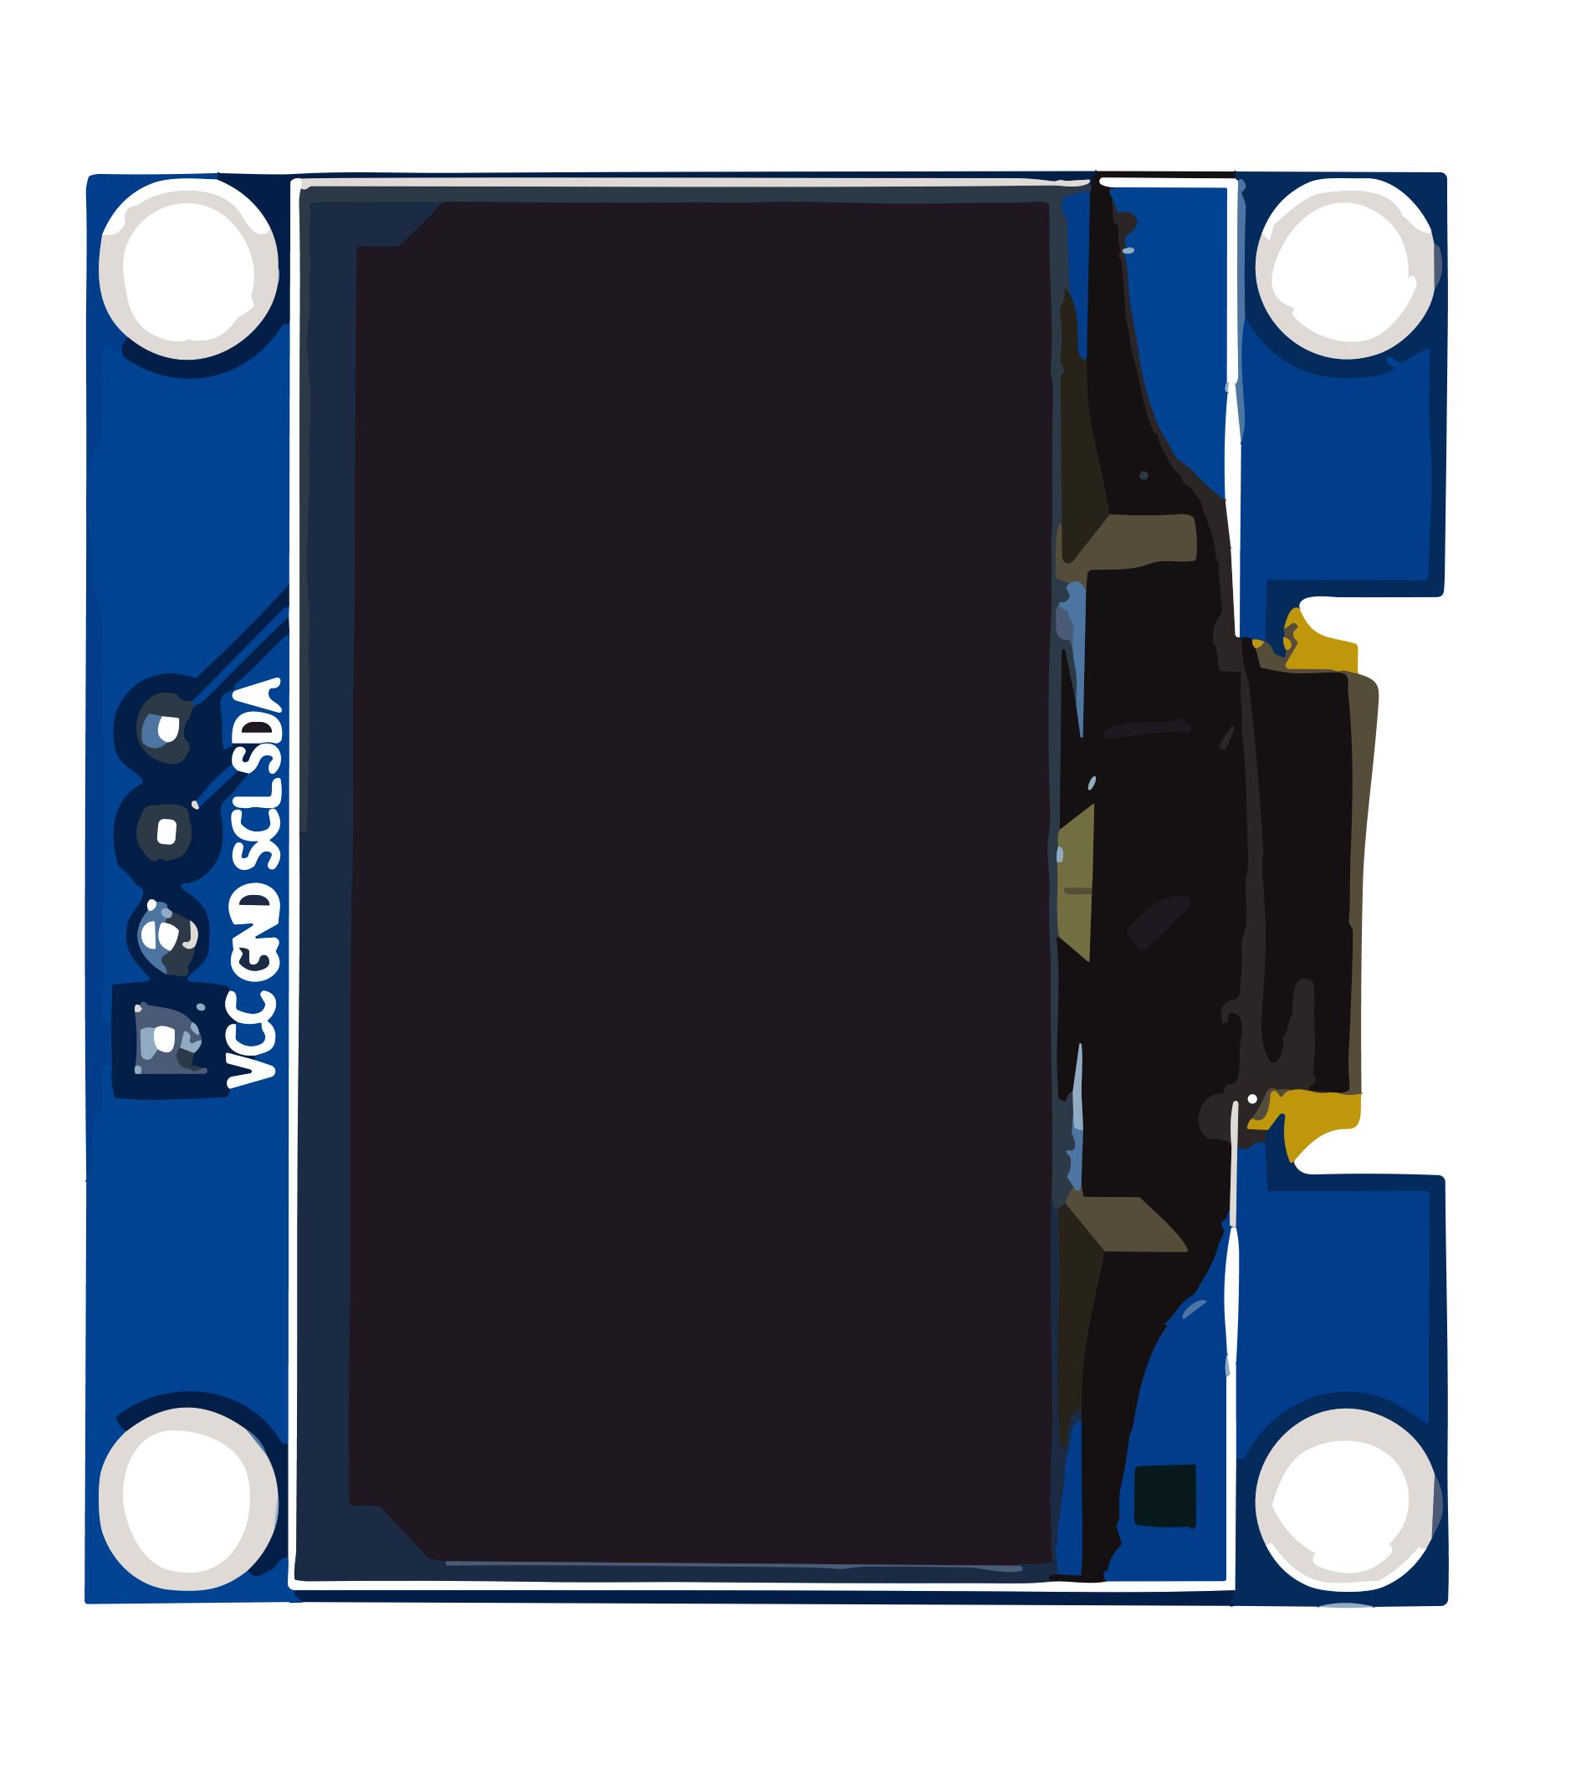
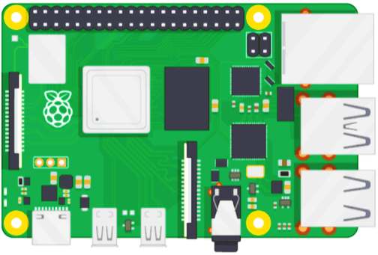
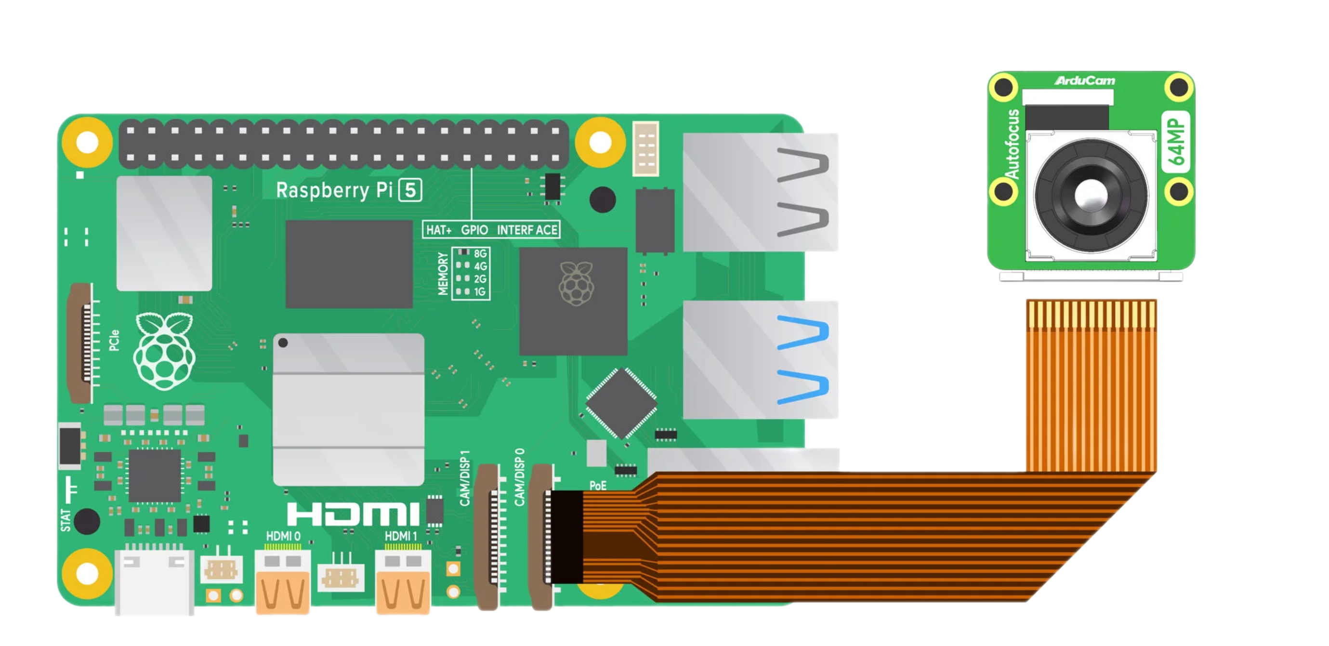

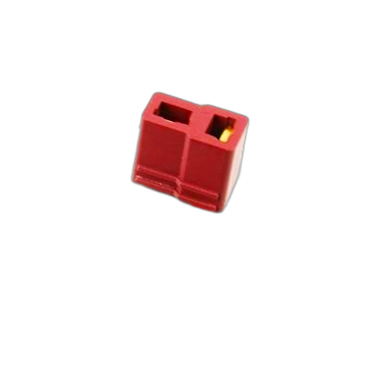
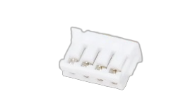
OLED GND -> Mpu9250 GND
Out(-) –> Raspberry pi GND
Sc5- PCA2 scl
Sd5- PCA2 sda
Sc5- oled scl
Sd5- oled sda
Sc5- PCA1 scl
Sd5- PCA1 sda
PI 4
Two PCA power (2A)
Six Servo Motor power (5.2 A)
4B+
Six Servo Motor power (5.2A)
Five Servo Motor power (5A)
USB Audio Drive
PI 5
Microphone
Speaker
11.1v, 3s
ARCEUS CIRCUIT
DIAGRAM
I
Lipo battery
0
Five Servo Motor power (5A)
Five Servo Motor power (5A)

